Slide 1


Image Super-Resolution
Digital Signal and Image Management Project
University of Milano-Bicocca
Matteo Breganni 869549
Francesco Cavallini 920835

Slide 2
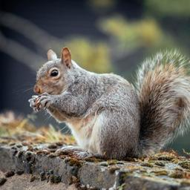
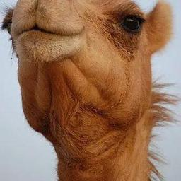
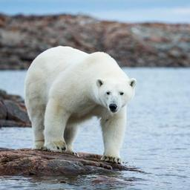
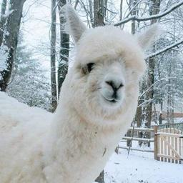
Dataset Description
Mammals dataset [1]
45 Categories, 13751 images
60-20-20 Train/Val/Test split, category specific
Index-Category dictionaries saved for later use
[1] https://www.kaggle.com/datasets/asaniczka/mammals-image-classification-dataset-45-animals

Slide 3
Pre-Trained CNN Approach

Slide 4
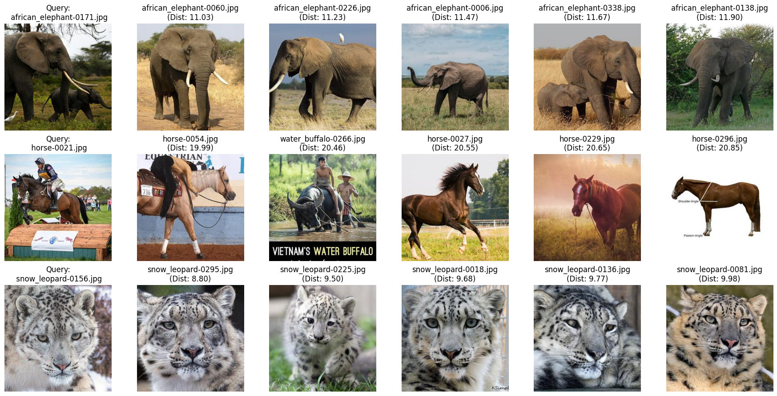
Pre-Trained CNN
Features extraction with MobileNetV2
Train features to build the KD-Tree
Example query with k=5:

Slide 5
Pre-Trained CNN: Evaluation
Results evaluated with k=3
Accuracy: 86,20%
ANMRR (Average Normalized Modified Retrieval Rank): 0.39
Dataframe created to better nagivate the classification report’s results
Sorted by F1-Score:
Class | Precision | Recall | F1-Score
orangutan | 0.98 | 0.99 | 0.99
red_panda | 0.99 | 0.99 | 0.99
snow_leopard | 0.98 | 0.98 | 0.98
porcupine | 0.97 | 0.95 | 0.96
armadillo | 0.95 | 0.96 | 0.96
Class | Precision | Recall | F1-Score
seal | 0.58 | 0.52 | 0.55
sea_lion | 0.66 | 0.61 | 0.64
yak | 0.69 | 0.70 | 0.70
vicuna | 0.68 | 0.73 | 0.70
walrus | 0.79 | 0.66 | 0.72

Slide 6
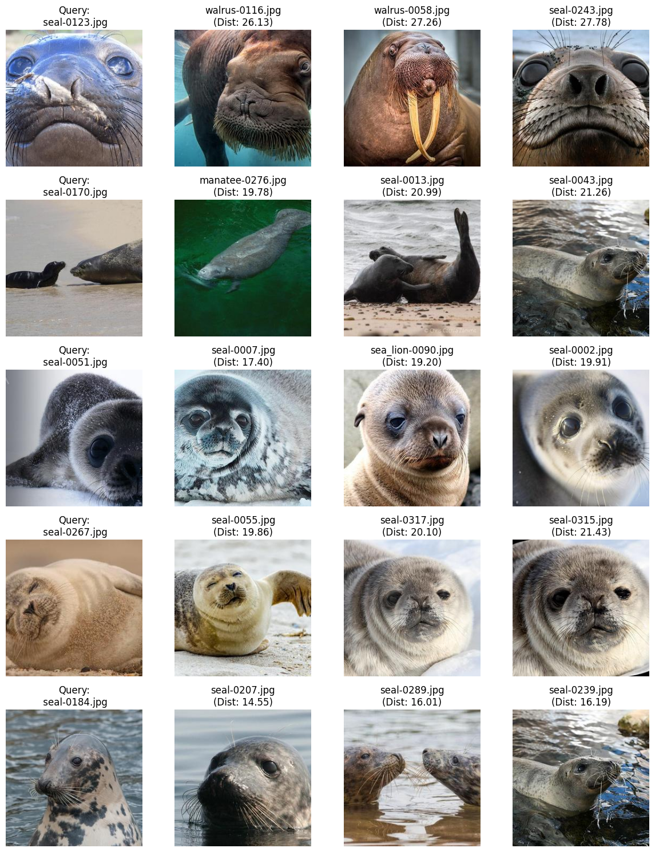
Pre-Trained CNN: Evaluation
Testing the worst class (seal)
F1-Score: 0.55 (overall accuracy was 86,20%)
Class-specific ANMRR (5 test images, 3 retrieved images each): 0.47 (was 0.39)
Often confused with similar animals like:
Walrus
Mantee
Sea lion

Slide 7
Siamese Network Approach

Slide 8
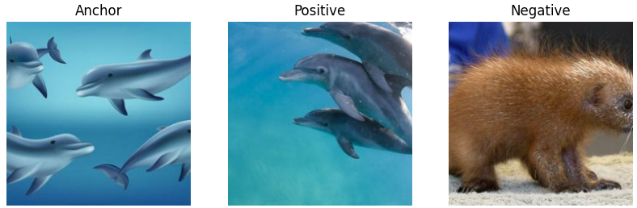
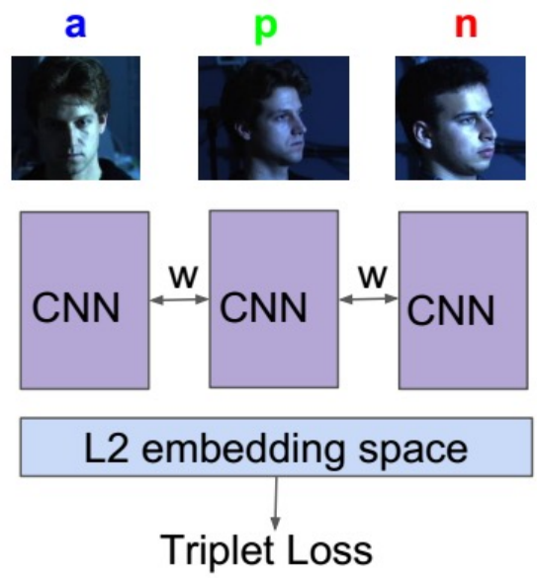
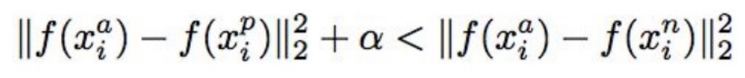
Siamese Network
The Siamese Network requires:
Encoder model (CNN shared between the images that extracts their embedding)
Triplet loss that evaluates the results on:
Anchor (reference image)
Positive (image from the same class as the anchor)
Negative (image from a different class)
Layer Type | Output Shape | Param #
Input | (244, 244, 3) | 0
Conv, 64, 3x3 | (244, 244, 64) | 1792
Batch normalization + max pooling 2x2 | (112, 112, 64) | 256
Conv, 128, 3x3 + max pooling 2x2 | (56, 56, 128) | 73,856
Conv, 256, 3x3 + max pooling 2x2 | (28, 28, 256) | 295,168
Global Average Pooling | (256) | 0
Dense, 128 | (128) | 32,896

Slide 9
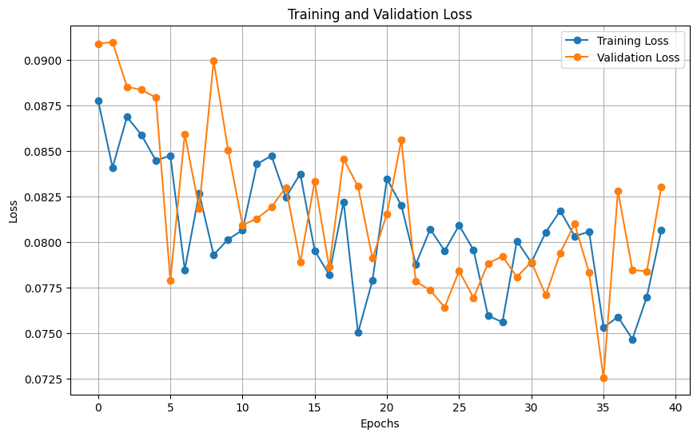
Siamese Network: Training Results
Terrible training results
Barely any learning
Network too small
Bigger network would be harder and more expensive to train
Output features of the encoder are too few (128) for the 45 categories

Slide 10
Siamese Network: Evaluation
Terrible peformance on the KD-Tree:
Accuracy: 12,14%
ANMRR: 0.88
Even the best classes don’t have good performance
The worst classes are barely ever retrieved
Class | Precision | Recall | F1-Score
mantee | 0.44 | 0.45 | 0.44
blue_whale | 0.43 | 0.38 | 0.40
zebra | 0.50 | 0.30 | 0.37
polar_bear | 0.34 | 0.30 | 0.32
dolphin | 0.28 | 0.33 | 0.30
Class | Precision | Recall | F1-Score
Mongoose | 0.03 | 0.03 | 0.03
Rhinoceros | 0.03 | 0.04 | 0.03
Opossum | 0.04 | 0.05 | 0.04
Yak | 0.05 | 0.05 | 0.05
Squirrel | 0.05 | 0.05 | 0.05

Slide 11
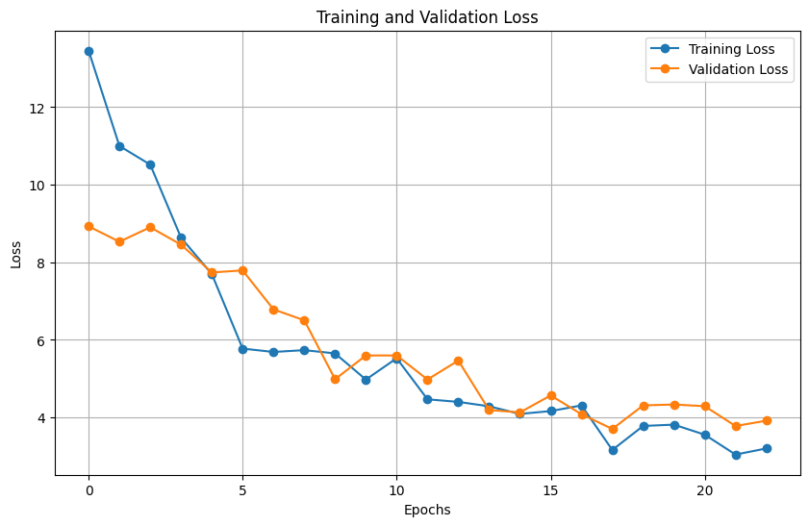
Fine-Tuned Siamese Network
Same structure of the Siamese Network (triplet loss)
Encoder network: MobileNetV2 with no freeze or added layer
Fine-tuning instead of training a big model from scratch to have a «hot start»
Much better learning process

Slide 12
FT Siamese Network: Evaluation
Performance slightly lower than the first method:
Accuracy: 83,80% (was 86,20%)
ANMRR: 0.40 (was 0.39)
Very similar on the top classes
Slightly different on the worst classes
Class | Precision | Recall | F1-Score
red_panda | 0.99 | 1 | 0.99
snow_leopard | 0.98 | 0.97 | 0.98
porcupine | 0.98 | 0.94 | 0.96
orangutan | 0.96 | 0.96 | 0.96
zebra | 0.95 | 0.96 | 0.95
Class | Precision | Recall | F1-Score
seal | 0.52 | 0.57 | 0.54
sea_lion | 0.63 | 0.51 | 0.56
yak | 0.70 | 0.69 | 0.70
blue_whale | 0.66 | 0.77 | 0.71
alpaca | 0.76 | 0.67 | 0.71

Slide 13
Comparison and Combination

Slide 14
Comparing the two best methods
Comparison dataframe created
F1-Score delta
Sorted by delta
The delta almost always favors the first method
Few classes favor the second method slightly
Class | F1-Score1 | F1-Score2 | Delta
alpaca | 0.84 | 0.71 | 0.13
camel | 0.88 | 0.76 | 0.12
tapir | 0.86 | 0.77 | 0.09
horse | 0.84 | 0.77 | 0.07
sea_lion | 0.64 | 0.57 | 0.07
Class | F1-Score1 | F1-Score2 | Delta
highland_cattle | 0.82 | 0.87 | -0.05
walrus | 0.72 | 0.74 | -0.02
vampire_bat | 0.80 | 0.82 | -0.02
vicuna | 0.70 | 0.72 | -0.02
african_elephant | 0.93 | 0.94 | -0.02

Slide 15
Combining the two best methods
Attempt to improve the performance by combining the two best methods
Normalize each array of feature arrays between 0 and 1
Concatenate each corresponding feature array (now twice the size)
Define a new KD-Tree with the new feature arrays
Test the KD-Tree with k=3
Accuracy: 87.09% <-- was 86,20% and 83,80%
ANMRR: 0.39 <-- was 0.39 and 0.40
Slight performance increase
Class | Precision | Recall | F1-Score
red_panda | 0.99 | 0.99 | 0.99
orangutan | 0.98 | 0.99 | 0.99
snow_leopard | 0.99 | 0.98 | 0.98
porcupine | 0.97 | 0.96 | 0.97
koala | 0.95 | 0.97 | 0.96
Class | Precision | Recall | F1-Score
seal | 0.58 | 0.58 | 0.58
sea_lion | 0.69 | 0.60 | 0.64
yak | 0.73 | 0.71 | 0.72
walrus | 0.80 | 0.70 | 0.75
water_buffalo | 0.77 | 0.73 | 0.76

Slide 16
First method vs Combined
First method results:
Combined method results:
The main difference is the slight increase in performance for the worst classes
Class | Precision | Recall | F1-Score
orangutan | 0.98 | 0.99 | 0.99
red_panda | 0.99 | 0.99 | 0.99
snow_leopard | 0.98 | 0.98 | 0.98
porcupine | 0.97 | 0.95 | 0.96
armadillo | 0.95 | 0.96 | 0.96
Class | Precision | Recall | F1-Score
seal | 0.58 | 0.52 | 0.55
sea_lion | 0.66 | 0.61 | 0.64
yak | 0.69 | 0.70 | 0.70
vicuna | 0.68 | 0.73 | 0.70
walrus | 0.79 | 0.66 | 0.72
Class | Precision | Recall | F1-Score
red_panda | 0.99 | 0.99 | 0.99
orangutan | 0.98 | 0.99 | 0.99
snow_leopard | 0.99 | 0.98 | 0.98
porcupine | 0.97 | 0.96 | 0.97
koala | 0.95 | 0.97 | 0.96
Class | Precision | Recall | F1-Score
seal | 0.58 | 0.58 | 0.58
sea_lion | 0.69 | 0.60 | 0.64
yak | 0.73 | 0.71 | 0.72
walrus | 0.80 | 0.70 | 0.75
water_buffalo | 0.77 | 0.73 | 0.76

Slide 17
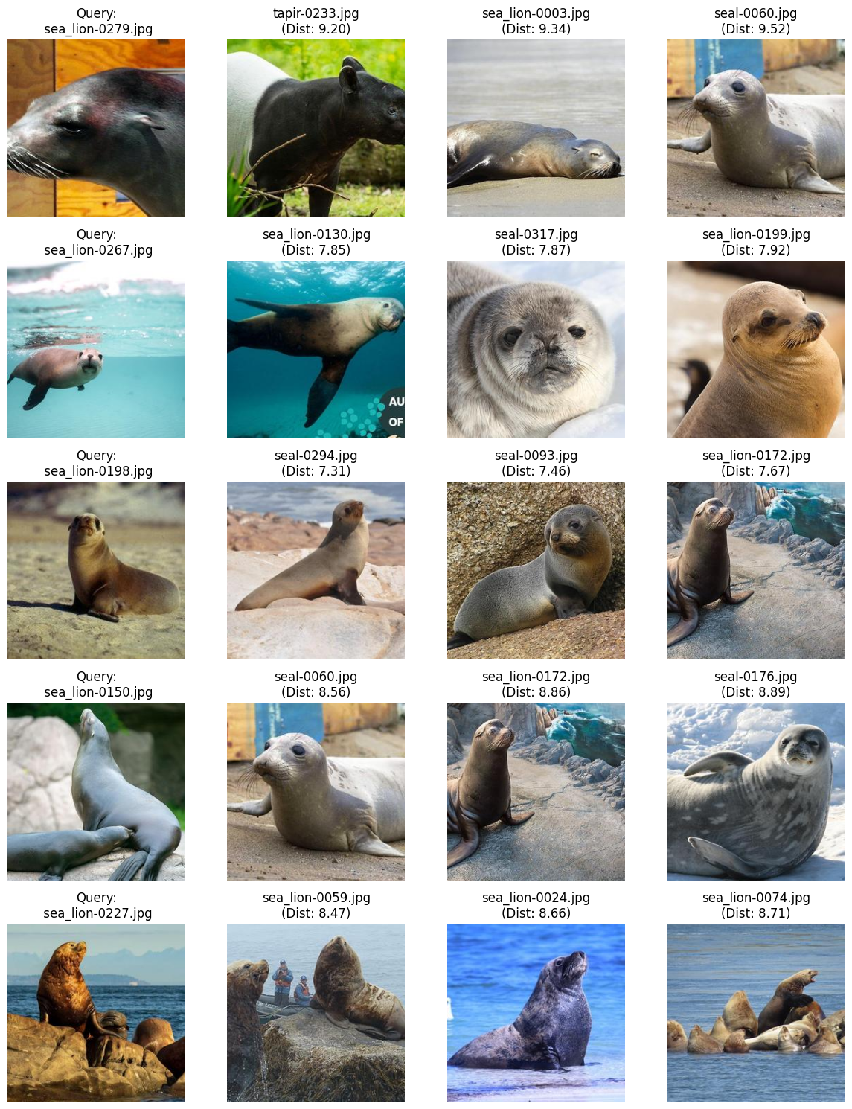
Evaluating the Combination
Testing the worst class (seal)
F1-Score: 0.58 (worst class was 0.55)
Class-specific ANMRR (5 test images, 3 retrieved images each): 0.44 (was 0.47)
Still struggling because of the high similarity with other classes like sea_lion
But better performance than before

Slide 18
Relevance Feedback

Slide 19


Relevance Feedback
Relevance feedback to improve the performance of the worst classes
Returning 10 images from the class «sea_lion»:
Only 4 of them are from the correct class
Manually flag each relevant (0, 1, 4, 9) and irrelavant (2, 3, 5, 6, 7, 8) image
Use the Rocchio Algorithm to calculate the new query:
Query = alpha * original_query + beta * relevant_mean – gamma * irrelevant_mean
with alpha=1, beta=0.75, gamma=0.15
The new query returns all correct images

Slide 20
Thanks for your attention

